Slide 1
Hybrid App. Dev
Using Visual Studio 2013

Slide 2
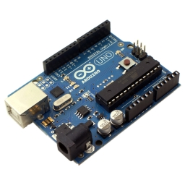
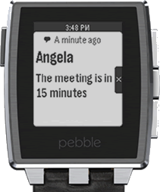
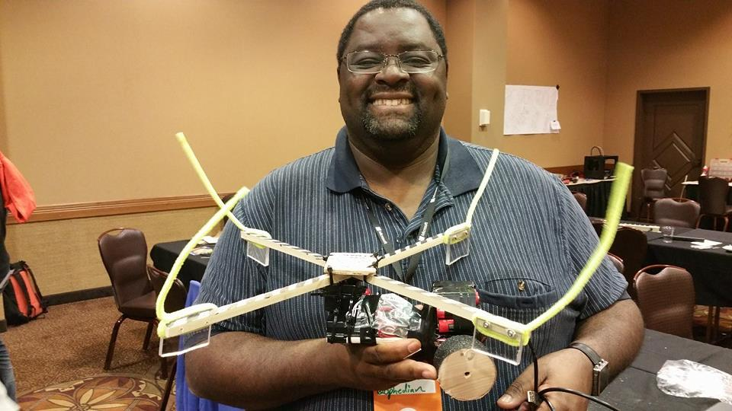
Abbey Gwayambadde
I dare you to say it fast 5 times
var i = {Husband, Dad, Presenter};
i.apply([Tall, Dark, Handsome, Geek]);
$(Philomath).on(Life, Tech, Dev);
Twitter:
@ophedian:
Skype:
AbbeyLG:
Email:
ophedian@gmail.com:
Git:
https://github.com/ophedian
Notes:
CodeMash Conference, Arduino, Pebble Watch

Slide 3
Presentation Audience
Knows
Visual Studio 2013
Web SDLC (ASPNET, MVC, MVVM, etc.)
Has used a mobile device
Familiar with the following technologies
HTML 4/5
CSS
JavaScript
General Mobile Development Concepts
Willingness to try new things
Notes:
Who is this presentation for?

Slide 4
What we are going to cover?
Setting up the Environment
Building a simple App
Testing the App
General discussion on Deployment
VS 2015 – Hybrid Support

Slide 5
What can I do?
Cordova Device/Feature Support
http://cordova.apache.org/docs/en/4.0.0/guide_support_index.md.html
HTML5 Device Support
http://caniuse.com/
Plugins
Cordova Plugins: http://plugins.cordova.io/#/viewAll
Cordova/Angular Integration: http://ngcordova.com/
Angular UI Integration: http://ionicframework.com/

Slide 6

Dev. Environment setup
Old Command Line Interface
NodeJS
Cordova
GIT
Apache Ant
Joyent NodeJs
Oracle JDK
Android SDK
Which version?
NPM
WebSocket4Net
Bower
Gulp/Grunt
Apple iTunes
Installation order?
Wait, do I need them?
Pain and Suffering
Notes:
Manual installation, dependencies… Bower → Need NPM → NodeJs

Slide 7
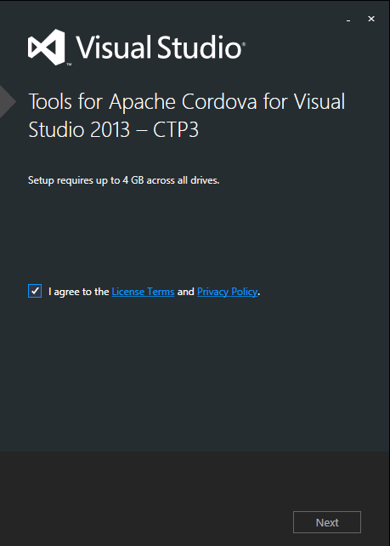
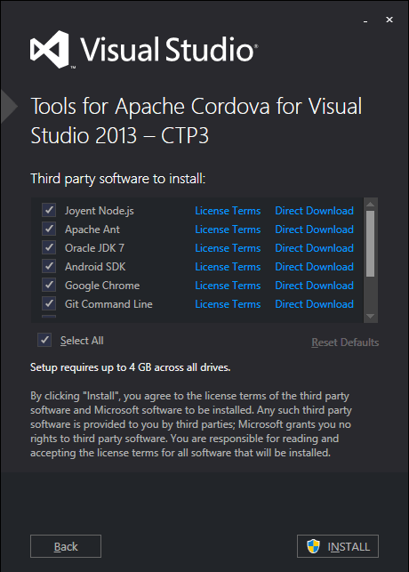

Dev. Environment setup
VS 2013 Hybrid App Installer
Oh, yeeaah !!
Notes:
Wonderful installer for CTP3
Demo environment
Solution File Walk Thru
-- Available Targets
-- Adding Plugins (no longer editing information)
-- Targeting Devices
-- Jasmine Unit Tests - Chutzpah
--

Slide 8
Lets Test
Browser Testing
Emulator Testing
Device Testing
Notes:
Demo

Slide 9



Browser Testing – The Engines
Chrome V8
WebKit
Safari Nitro
IE Chakra
Android OS
NodeJS
iPads
iPhones
Window Phone
WinRT Devices

Slide 10
Deployment Options
Developer License Costs
Windows Store: $19 Individual || $99 company
Google: $25
Apple: $99 Individual || $99 Company
A few options
A friend who has a mac ☺
PhoneGap Build
Mac In Cloud ($1 an hour)

Slide 11
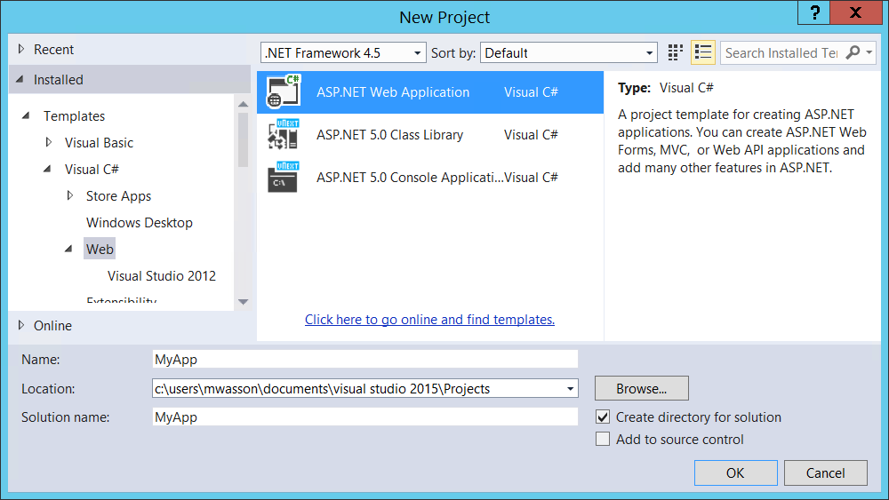
Visual Studio 2015 – Project Type

Slide 12
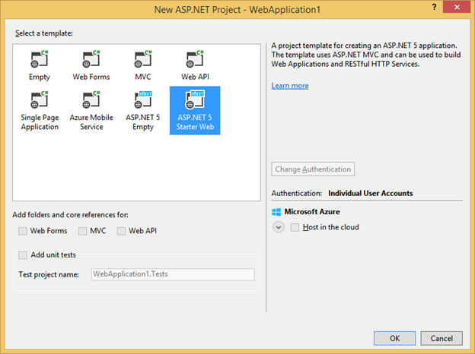

Slide 13
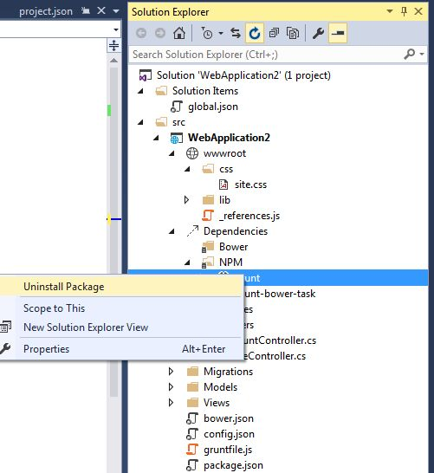
Say what?
Bower
NPM
Grunt build tasks

Slide 14
